Slide 1
Chapter 9
One- and Two-Sample Estimation Problems
Chapter 9
One- and Two-Sample Estimation Problem

Slide 2
Chapter 9.3
Classical Methods of Estimation
Classical Methods of Estimation
A point estimate of some population parameter θ is a single value θ of a statistic Θ.
For example, the value x of the statistic X, computed from a sample of size n, is a point estimate of the population parameter μ.
^
^
_
_
An estimator is not expected to estimate the population parameter without error.
We do not expect X to estimate μ exactly, but we certainly hope that it is not far off.
We would always choose an estimator Θ that has a mean equal to the parameter estimated. An estimator possessing this property is said to be unbiased.
_
^
^
A statistic Θ is said to be an unbiased estimator of the parameter θ if

Slide 3
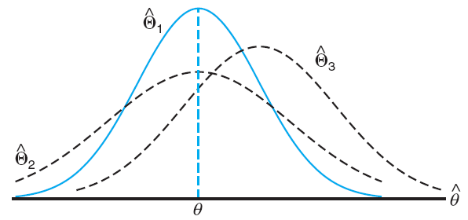
Chapter 9.3
Classical Methods of Estimation
Classical Methods of Estimation
If we consider all possible unbiased estimators of some parameter θ, the one with the smallest variance is called the most efficient estimator of θ.
^
The most efficient estimator is Θ₁
Which one is more efficient between Θ₂ and Θ₃?
^
^

Slide 4
Chapter 9.3
Classical Methods of Estimation
Interval Estimation
Even the most efficient unbiased estimate is unlikely to estimate the population parameter exactly.
It is unlikely that a point estimate from a given sample will be exactly equal to the population parameter it is supposed to estimate.
So, there are many situations in which it is preferable to determine an interval within which we would expect to find the value of the parameter.
Such an interval is called an interval estimation.
An interval estimate of a population parameter θ is an interval of the form , where and depend on the value of the statistic for a particular sample and also on the sampling distribution of .

Slide 5
Chapter 9.3
Classical Methods of Estimation
Interpretation of Interval Estimates
If, for instance, we find and such that
for 0 < α < 1, then we have a probability of 1 – α of selecting a random sample that will produce an interval containing θ.
The interval , computed from the selected sample, is then called a (1–α)100% confidence interval.
The fraction 1–α is called the confidence coefficient or the degree of confidence.
The endpoints are called the lower and upper confidence limits.

Slide 6
Chapter 9.3
Classical Methods of Estimation
Interpretation of Interval Estimate
Thus, when α = 0.05, we have a 95% confidence interval, when α = 0.01, we obtain a wider 99% confidence interval.
The wider the confidence interval is, the more confident we can be that the given interval contains the unknown parameter.
Degree of confidence must be so chosen that the data is useful for further application.
For example, it is better to be 95% confident that the average life of a certain television transistor is between 6 and 7 years than to be 99% confident that it is between 3 and 10 years.

Slide 7
Chapter 9.4
Single Sample: Estimating the Mean
Single Sample: Estimating the Mean
_
We already found out previously, that x is likely to be a very accurate estimate of μ when n is large.
Let us now consider the interval estimate of μ. If the sample is selected from a normal population or if n is sufficiently large, we can establish a confidence interval for μ by considering the sampling distribution of X.
_

Slide 8
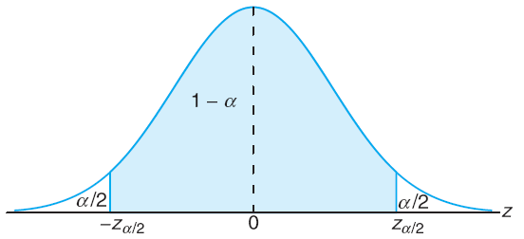
Chapter 9.4
Single Sample: Estimating the Mean
Estimating the Mean (known σ)
According to the Central Limit Theorem, we can expect the sampling distribution of X to be approximately normally distributed with mean and standard deviation given by
Writing z_{α/2} for the z-value above which we find an area of α/2, we can see from the figure below, that
where

Slide 9
Chapter 9.4
Single Sample: Estimating the Mean
Estimating the Mean (known σ)
We now calculate the (1–α)100% confidence interval of the mean of a random sample of size n selected from a population whose variance σ² is known by the resulting formula.
_
If x is the mean of a random sample of size n from a population with known variance σ², a (1–α)100% confidence interval for μ is given by
where z_{α/2} is the z-value leaving an area of α/2 to the right.
The case of σ known

Slide 10
Chapter 9.4
Single Sample: Estimating the Mean
Estimating the Mean (known σ)
The average zinc concentration recovered from a sample of zinc measurements in 36 different locations is found to be 2.6 g/ml. Find the 95% and 99% confidence intervals for the mean zinc concentration in the river. Assume that the population standard deviation is 0.3.
Degree of confidence 95%
Degree of confidence 99%

